Slide 1
Assessment of Minorities Access to Finance
#Discriminatory Lending
by Emi Harry

Slide 2
Table of Contents
Introduction
Background
Project Goal
Methodology
Data Preprocessing
Data Visualization
Machine Learning
Results
Conclusion
References

Slide 3

Introduction
What is the “American Dream”?
How do people attain this dream?
Access to finance is the opportunity for individuals get loans that enable them to fund expenses that they cannot immediately afford.

Slide 4
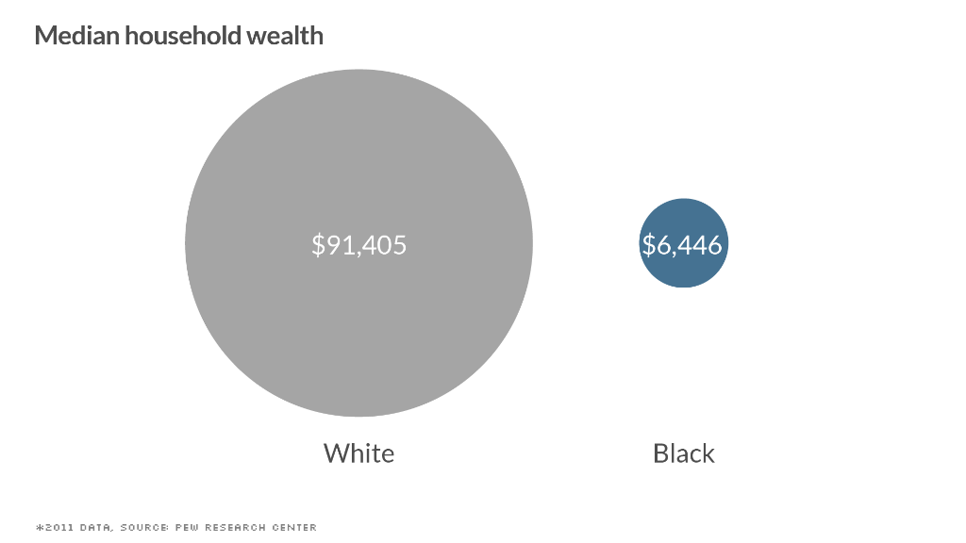
Introduction Cont’d
An article on CNN Money by Tami Luhby, which was published in 2014 stated that the average black household had amassed less than one-tenth of the wealth of a typical white one.
The research carried out by Brandeis University, they showed that the financial/wealth gap between blacks and whites had nearly tripled as seen in the figure.

Slide 5
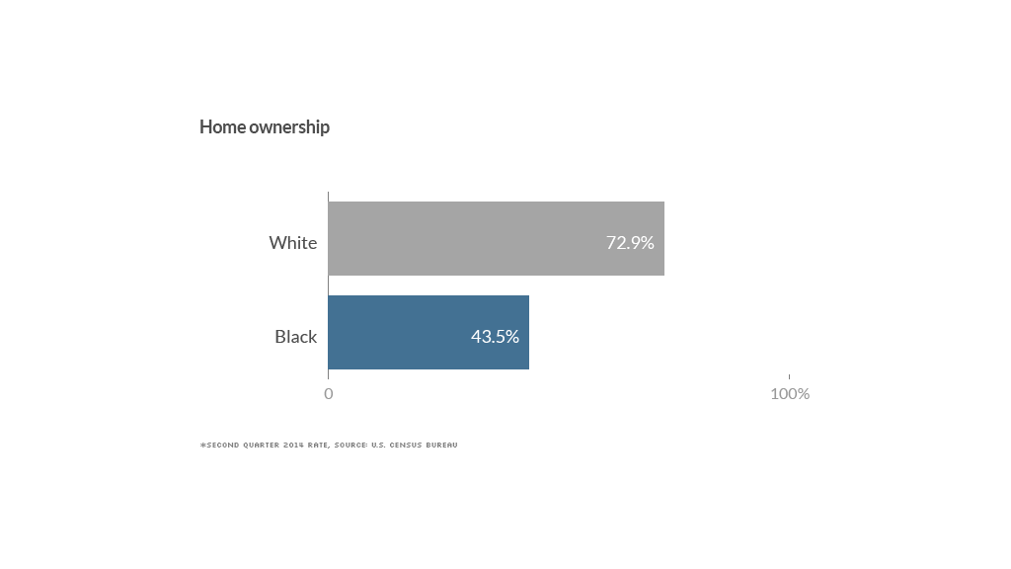
Introduction Cont’d
The greatest factor in this wealth gap is due to the fact that home ownership among blacks is so much lower. With the explanation that in America, housing is often the greatest asset and a major component of overall wealth.

Slide 6
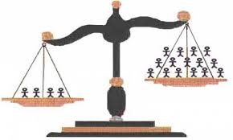
Introduction: Background
The term “Redlining” has been used over the years to describe a perpetual form of discrimination; where financial institutions refused to provide their services to neighbourhoods they termed as “African-American” neighbourhoods. It started in 1933 in the Roosevelt era.
Home Mortgage Disclosure Act (HMDA)! was passed in 1975.
Consumer Financial Protection Bureau (CFPB); an agency of the United States government which was established in July 2011

Slide 7

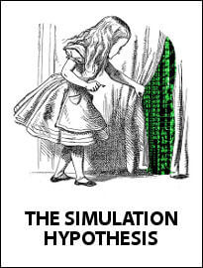
Introduction: Project Goal
Hypothesis
In this research, the hypothesis is that race plays a huge role in the decision-making process of home mortgage approvals or denials, and it has not improved since the last major report on it in 2014.

Slide 8
Methodology

Slide 9
Methodology: Data Preprocessing
The data was downloaded from CFPB, total size was 100GB
The data contains codes and labels
Not all the codes are relevant for the study.
Step 1 Initial Read
Step 2 Write Functions
Step 3 Change Structure
Read in 5000 rows
Identify relevant features
Batch read and clean
Batch bind
Convert data class
Normalize data

Slide 10
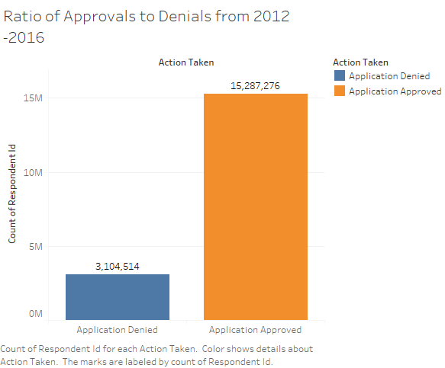
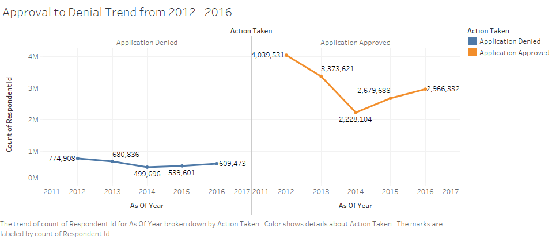
Methodology: Data Visualization
Question 1: What is the overall ratio of loan approvals to denials from 2012 to 2016?
Question 2: Has there been a consistent increase in the loan approvals from 2012 to 2016?

Slide 11
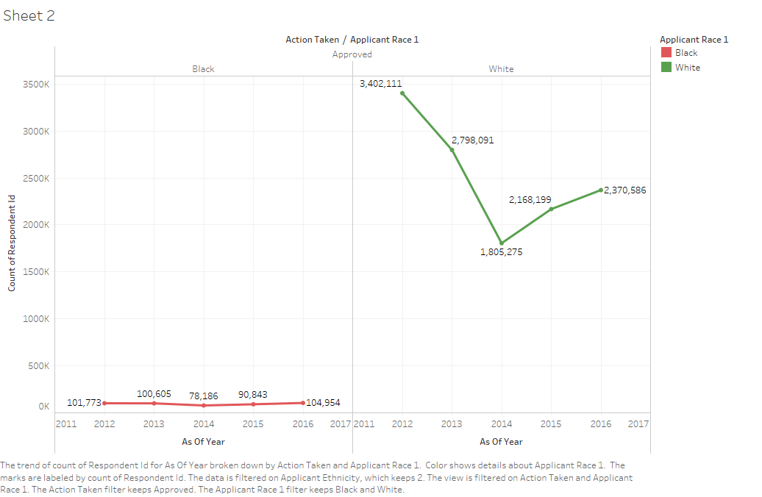
Data Visualization Cont’d
Question 3: What is the trend in approvals and denials by race from 2012 to 2016?

Slide 12
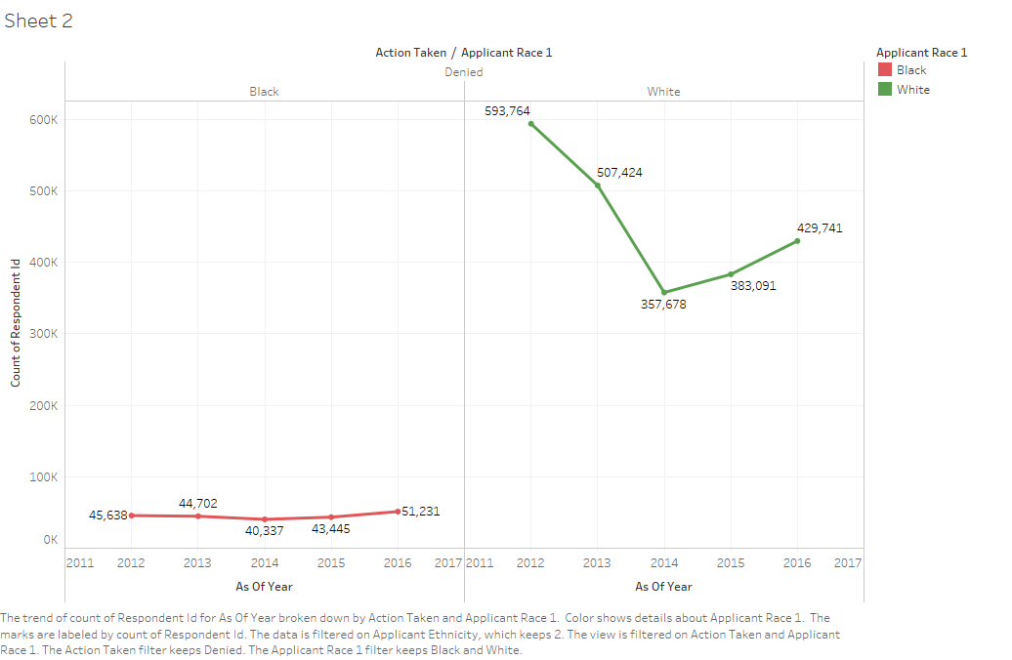

Slide 13

Methodology: Machine Learning
C5.0 and Neural Networks were used
Predicted on action taken
Predicted on race

Slide 14

Machine Learning: Predicting on Action Taken
Step 1 Balanced Sub-setting
Step 2 Feature Selection
Step 3 Model Training
Split data by action taken
Split again by year randomly
Train C5 and Net models with 1st part
Rank features by importance
Split second partition into 2: 80% training, 20% testing
Train 2 models per algorithm; one with racial features, and the other without.
Merge and split into 2

Slide 15
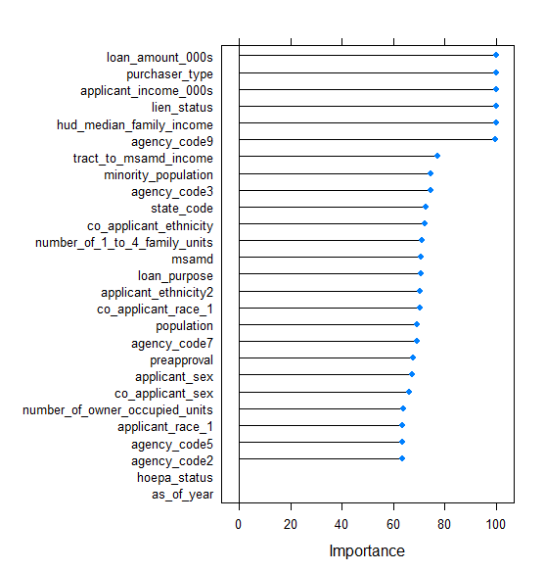
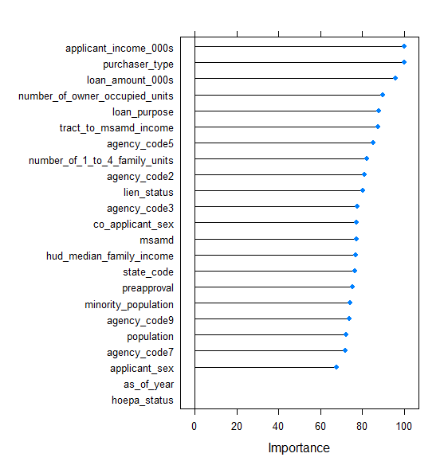
Predicting on Action Taken: C5.0 Features
Model with racial features
Model without racial features

Slide 16
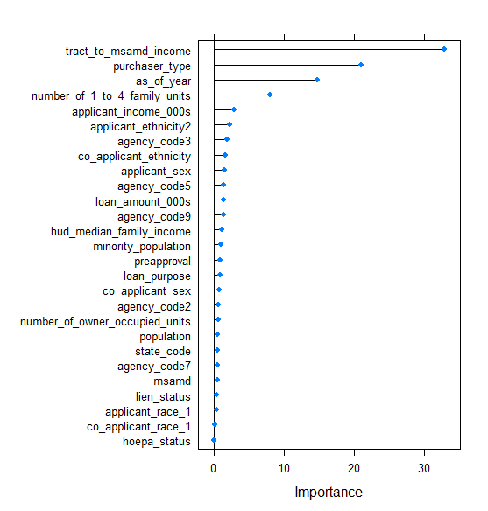
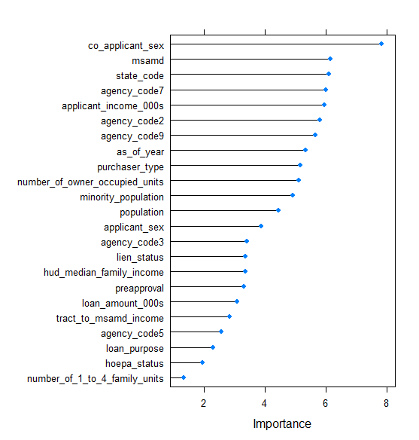
Predicting on Action Taken: Neural Network Features
Model with racial features
Model without racial features

Slide 17
Neural Network Setup
Input layer – 21 variables
Hidden layers – 5 layers
Nodes – 5 nodes per layer
Entropy fitting; decay = 0.1

Slide 18

Machine Learning: Predicting on Race
Step 1 Balanced Sub-setting
Step 2 Feature Selection
Step 3 Model Training
Split data by race
Split again by year randomly
Train C5 and Net models with 1st part
Rank features by importance
Split second partition into 2: 80% training, 20% testing
Train 2 models per algorithm; one with racial features, and the other without.
Merge and split into 2

Slide 19
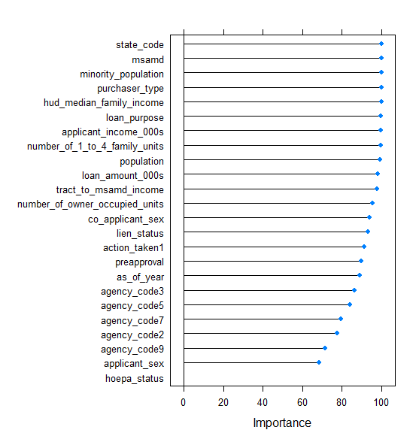
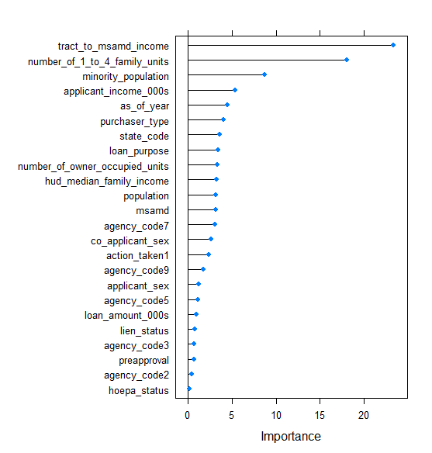
Predicting on Race: Features
C5 Feature ranking
Neural Network Feature ranking

Slide 20
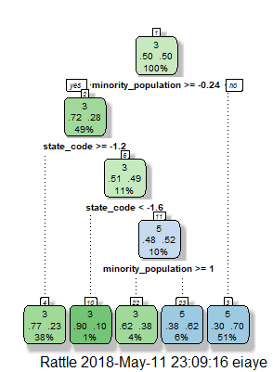
Predicting on Race Cont’d
Decision tree

Slide 21
Results

Slide 22
Predicting on Action Taken: C5.0 Results
With racial features
Without racial features
Confusion Matrix of C5.0 Decision with Racial Features
 | Denied | Approved | Total Predictions
Denied | 6812 | 1525 | 8337
Approved | 188 | 5475 | 5663
Total Actuals | 7000 | 7000
Confusion Matrix of C5.0 Decision without Racial Features
 | Denied | Approved | Total Predictions
Denied | 6666 | 1536 | 8202
Approved | 334 | 5464 | 5798
Total Actuals | 7000 | 7000
In comparing the approval rate of black and white applicants in both C5.0 models, it can be observed that in the first model, their approval rates are approximately 76% and 78% respectively, while in the second model, their approval rates are approximately 77% and 79% respectively.

Slide 23
Predicting on Action Taken: Neural Net Results
With racial features
Without racial features
Confusion Matrix of C5.0 Decision with Racial Features
 | Denied | Approved | Total Predictions
Denied | 6812 | 1525 | 8337
Approved | 188 | 5475 | 5663
Total Actuals | 7000 | 7000
Confusion Matrix of C5.0 Decision without Racial Features
 | Denied | Approved | Total Predictions
Denied | 6666 | 1536 | 8202
Approved | 334 | 5464 | 5798
Total Actuals | 7000 | 7000
In comparing the approval rate of black and white applicants in both NNET models, it can be observed that in the first model, their approval rates are approximately 74% and 76% respectively, while in the second model, their approval rates are approximately 73% and 75% respectively.

Slide 24
Predicting on Race
C5.0 Confusion Matrix
Neural Network Confusion Matrix
Confusion Matrix of C5.0 Race Predictions
 | Black | White | Total Predictions
Black | 10519 | 3044 | 13563
White | 3481 | 10956 | 14437
Total Actuals | 14000 | 14000
Confusion Matrix of NNET Race Predictions
 | Black | White | Total Predictions
Black | 9655 | 3484 | 13139
White | 4345 | 10516 | 14861
Total Actuals | 14000 | 14000
C5.0 - 32% of the black applicants who were approved were misclassified and 18% of the white applicants were misclassified as black. In the case of the denials, 11% of the black applicants were misclassified as white, and 40% of the white applicants were misclassified.
NNET - 41% of the black applicants who were approved were misclassified and 24% of the white applicants who were approved were misclassified. In the case of the denials, 12% of the black applicants were misclassified, and 50% of the white applicants were misclassified.

Slide 25
Conclusion
All approved black applicants are twice as likely to be misclassified as white, than approved white applicants as black.
All denied white applicants are four times more likely to be misclassified as black, than the denied applicants as white.
Hence the hypothesis stands true that since the last report in 2014, discriminatory lending still exists.

Slide 26

Further Work
Re-run the study with new data
Research on how a fair system can be implemented, back by the blockchain technology
Q & A
THANK YOU!

Slide 27
References
Staff, I. (2018, March 16). Home Mortgage Disclosure Act (HMDA). Retrieved from https://www.investopedia.com/terms/h/home-mortgage-disclosure-act-hmda.asp
Luhby, T. (2014, August 21). 5 disturbing stats on black-white inequality Retrieved from http://money.cnn.com/2014/08/21/news/economy/black-white-inequality/index.html
Morris, M. W. (2009). Discrimination and Mortgage Lending in America (pp. 2-3, Publication). Baltimore, MD: NAACP.
National Community Reinvestment Coalition, The 2005 Fair Lending Disparities: Stubborn and Persistent II (Washington, DC: National Community Reinvestment Coalition, 2006), http://www.ncrc.org/images/stories/pdf/research/ncrc%202005%20hmda%20report.pdf
Federal Home Loan Mortgage Corporation, Annual Report (McLean, VA: Federal Home Loan Mortgage Corporation, 2007).
U.S. Department of Housing and Urban Development, Unequal Burden.
Ibid.
Center for Responsible Lending, http://www.responsiblelending.org, 2009. See also A. Rivera, B. Cotto‐Escalara, A. Desai, J. Huezo, and D. Muhammad, Foreclosed: State of the Dream (Boston, MA: United for a Fair Economy, 2008).
Gaspaire, Brent. “Redlining (1937- ).” BlackPast.org Remembered and Reclaimed, www.blackpast.org/aah/redlining-1937.

Slide 28
Appendix – section 1
Breakdown of C5.0 model predicting action taken (with racial features) confusion matrix by race
Confusion Matrix of C5.0 Decision with Racial for Black Applicants
 | Denied | Approved | Total Predictions
Denied | 1525 | 344 | 1869
Approved | 27 | 1109 | 1136
Total Actuals | 1552 | 1453
Confusion Matrix of C5.0 Decision with Racial for White Applicants
 | Denied | Approved | Total Predictions
Denied | 1412 | 343 | 1755
Approved | 42 | 1192 | 1234
Total Actuals | 1454 | 1535
Accuracy : 0.8776
Sensitivity : 0.9731
Specificity : 0.7821
Pos Pred Value : 0.8171
Neg Pred Value : 0.9668
Prevalence : 0.5000
Detection Rate : 0.4866
Detection Prevalence : 0.5955

Slide 29
Appendix – section 1 cont’d
Breakdown of C5.0 model predicting action taken (without racial features) confusion matrix by race
Confusion Matrix of C5.0 Decision without Racial Features for Black Applicants
 | Denied | Approved | Total Predictions
Denied | 1486 | 341 | 1827
Approved | 66 | 1112 | 1178
Total Actuals | 1552 | 1453
Confusion Matrix of C5.0 Decision for without Racial Features White Applicants
 | Denied | Approved | Total Predictions
Denied | 1372 | 326 | 1698
Approved | 82 | 1209 | 1291
Total Actuals | 1454 | 1535
Accuracy : 0.8664
Sensitivity : 0.9523
Specificity : 0.7806
Pos Pred Value : 0.8127
Neg Pred Value : 0.9424
Prevalence : 0.5000
Detection Rate : 0.4761
Detection Prevalence : 0.5859

Slide 30
Appendix – section 2
Breakdown of Neural Network model predicting action taken (with racial features) confusion matrix by race
Confusion Matrix of NNET Decision with Racial Features for Black Applicants
 | Denied | Approved | Total Predictions
Denied | 1543 | 380 | 1923
Approved | 9 | 1073 | 1082
Total Actuals | 1552 | 1453
Confusion Matrix of NNET Decision for with Racial Features White Applicants
 | Denied | Approved | Total Predictions
Denied | 1432 | 367 | 1799
Approved | 22 | 1168 | 1190
Total Actuals | 1454 | 1535
Accuracy : 0.8702
Sensitivity : 0.9897
Specificity : 0.7507
Pos Pred Value : 0.7988
Neg Pred Value : 0.9865
Prevalence : 0.5000
Detection Rate : 0.4949
Detection Prevalence : 0.6195

Slide 31
Appendix – section 2 cont’d
Breakdown of Neural Network model predicting action taken (without racial features) confusion matrix by race
Confusion Matrix of NNET Decision without Racial Features for Black Applicants
 | Denied | Approved | Total Predictions
Denied | 1550 | 394 | 1944
Approved | 2 | 1059 | 1061
Total Actuals | 1552 | 1453
Confusion Matrix of NNET Decision for without Racial Features White Applicants
 | Denied | Approved | Total Predictions
Denied | 1447 | 407 | 1854
Approved | 7 | 1128 | 1135
Total Actuals | 1454 | 1535
Accuracy : 0.8674
Sensitivity : 0.9960
Specificity : 0.7389
Pos Pred Value : 0.7923
Neg Pred Value : 0.9946
Prevalence : 0.5000
Detection Rate : 0.4980
Detection Prevalence : 0.6286

Slide 32
Appendix – section 3
Breakdown of C5.0 model predicting race confusion matrix by action taken
Confusion Matrix of C5.0 Race Predictions by Approvals
 | Black | White | Total Predictions
Black | 6401 | 2057 | 8458
White | 2955 | 9453 | 12408
Total Actuals | 9356 | 11510
Confusion Matrix of C5.0 Race Predictions by Denials
 | Black | White | Total Predictions
Black | 4118 | 987 | 5105
White | 526 | 1503 | 2029
Total Actuals | 4644 | 2490
Accuracy : 0.767
Sensitivity : 0.7514
Specificity : 0.7826
Pos Pred Value : 0.7756
Neg Pred Value : 0.7589
Prevalence : 0.5000
Detection Rate : 0.3757
Detection Prevalence : 0.4844

Slide 33
Appendix – section 3 cont’d
Breakdown of Neural Network model predicting action taken (without racial features) confusion matrix by race
Confusion Matrix of NNET Race Predictions by Approvals
 | Black | White | Total Predictions
Black | 5565 | 2244 | 7809
White | 3791 | 9266 | 13057
Total Actuals | 9356 | 11510
Confusion Matrix of NNET Race Predictions by Denials
 | Black | White | Total Predictions
Black | 4090 | 1240 | 5330
White | 554 | 1250 | 1804
Total Actuals | 4644 | 2490
Accuracy : 0.7204
Sensitivity : 0.6896
Specificity : 0.7511
Pos Pred Value : 0.7348
Neg Pred Value : 0.7076
Prevalence : 0.5000
Detection Rate : 0.3448
Detection Prevalence : 0.4692

